Slide 1
Introduction & History of Computers

Slide 2
Topics of Discussion
Introduction to Computer
History and evolution of computing devices
Generations of computers
Classification of computers
Applications of Computer

Slide 3
What’s a Computer?
A computer is an electronic machine that takes input from the user, processes the given input and generates output in the form of useful information.

Slide 4
What is a Computer?
A computer is a multipurpose electronic device that can receive, process and store data.
Operates under the control of instructions stored in its own memory
Instructions allow the computer to accept data, manipulate the data according to specified rules, produce results, and store the results for future use.
A computer has input, processing, storage and output.
Examples of computers: Desktop computers, laptops, smart phones, office calculator, Point of Sale systems etc.

Slide 5
What’s a Computer?
A computer includes various devices:
Central Processing Unit (CPU) processing
Monitor - output
Keyboard and Mouse input
Memory- storage

Slide 6
What’s a Computer?
The unique capabilities and characteristics of a computer:
Speed
Storage capacity
Accuracy
Reliability
Versatility
Diligence

Slide 7
Computing concepts
Accepting the raw data
Processing the data
Storing the data
Delivering the output

Slide 8
Evolution of Computers
Manual Computing Devices: Sand table, Abacus, …
Automated Computing Devices: difference engine, analytical engine, Colossus, …
Charles Babbage: A professor of mathematics a the Cambridge University is considered to be the father of modern computer.

Slide 9
Generations of Computers
First Generation Computers
Employed during the period 1940-1956
Used the vacuum tubes technology for calculation as well as for storage and control purpose.
Advantages: (1) Fastest computing devices of their time; (2) These computers were able to execute complex mathematical problems in an efficient manner.

Slide 10
Generations of Computers
Disadvantages:
(1) The functioning of these computers depended on the machine language.
(2) There were generally designed as special-purpose computers.
(3) The use of vacuum tube technology make these computers very large and bulky.
(4) They were not easily transferable from one place to another due to their huge size and also required to be placed in cool places.
(5) They were single tasking because they could execute only one program at a time.
(6) The generated huge amount of heat and hence were prone to hardware faults.

Slide 11
Generations of Computers
Second Generation Computers
Employed during the period 1956-1963
Use transistors in place of vacuum tubes in building the basic logic circuits.
Advantages: (1) Fastest computing devices of their time; (2) Easy to program because of the use assembly language; (3) Could be transferred from one place to other very easily because they were small and light; (4) Require very less power in carrying out their operations; (5) More reliable, did not require maintenance at regular intervals of time.

Slide 12
Generations of Computers
Disadvantages:
(1)The input and output media were not improved to a considerable extent
(2) Required to be placed in air-conditioned places
(3) The cost of these computers was very high and they were beyond the reach of home users
(4) Special-purpose computers and could execute only specific applications

Slide 13
Generations of Computers
Third Generation Computers
Employed during the period 1964-1975
Use of Integrated Circuits
Advantages: (1) Fastest computing devices; (2) Very productive; (3) Easily transportable from one place to another because of their small size; (4) Use high-level languages; (5) Could be installed very easily and required less space; (6) Can execute any type of application. (7) More reliable and require less frequent maintenance schedules.

Slide 14
Generations of Computers
Disadvantages:
(1)The storage capacity of these computers was still very small;
(2) The performance of these computers degraded while executing large applications, involving complex computations because of the small storage capacity;
(3) The cost of these computers was very high;
(4) They were still required to be placed in air-conditioned places.

Slide 15
Generations of Computers
Fourth Generation Computers
Employed during 1975-1989
Use of Large Scale Integration technology and Very Large Scale Integration technology
The term Personal Computer (PC) became known to the people during this era.

Slide 16
Generations of Computers
Advantages:
(1) Very powerful in terms of their processing speed and access time;
(2) Storage capacity was very large and faster;
(3) Highly reliable and required very less maintenance;
(4) User-friendly environment;
(5) Programs written on these computers were highly portable;
(6) Versatile and suitable for every type of applications;
(7) Require very less power to operate.

Slide 17
Generations of Computers
Disadvantages:
(1) The soldering of LSI and VLSI chips on the wiring board was not an easy task and required complicated technologies to bind these chips on the wiring board;
(2) The working of these computers is still dependent on the instructions given by the programmer.

Slide 18
Generations of Computers
Fifth Generation Computers
The different types of modern digital computers come under this category.
Use Ultra Large Scale Integration technology that allows almost ten million electronic components to be fabricated on one small chip.

Slide 19
Generations of Computers
Advantages:
(1) Fastest and powerful computers till date;
(2) Being able to execute a large number of applications at the same time and that too at a very high speed;
(3) Decreasing the size of these computers to a large extent;
(4)The users of these computers find it very comfortable to use them because of the several additional multimedia features;
(5) They are versatile for communications and resource sharing.

Slide 20
Classification of Computers
We can classify the computers according to the following three criteria:
(1) Based on operating principles
(2) Based on applications
(3) Based on size and capability

Slide 21
Classification of Computers
(1) Based on operating principles:
Analog computers: represent data in the form of continuous electrical signals having a specific magnitude
Digital computers: store and process data in the digital form.
Hybrid computers: a combination of analog computer and digital computer because it encompasses the best features of both.

Slide 22
Classification of Computers
(2) Based on applications:
General purpose computers: can work in all environments.
Special purpose computers: can perform only a specified task.

Slide 23
Classification of Computers
(3) Based on size and capability
Microcomputers: Designed to be used by individuals.
Mini Computers: Can handle more data and more input and output than micro computers.
Mainframe Computers: A very large computer
Super Computers: The fastest type of computer that can perform complex operations at a very high speed.

Slide 24
Types of computing devices

Slide 25
Types of Computing devices

Slide 26
Types of computing devices

Slide 27
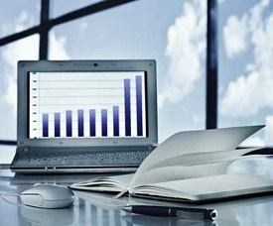
Computer Application - Business
A computer has high speed of calculation, diligence, accuracy, reliability, or versatility which has made it an integrated part in all business organizations.
Computer is used in business organizations for −
Payroll calculations
Budgeting
Sales analysis
Financial forecasting
Managing employee database
Maintenance of stocks, etc.

Slide 28
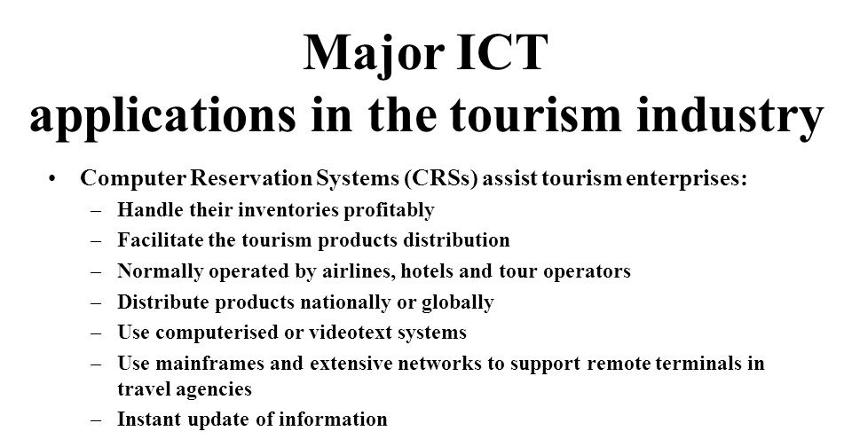

Slide 29
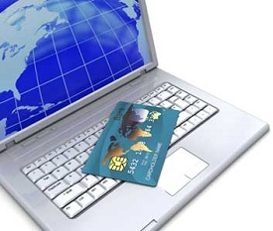
Computer Application - Banking
Today, banking is almost totally dependent on computers.
Banks provide the following facilities −
Online accounting facility, which includes checking current balance, making deposits and overdrafts, checking interest charges, shares, and trustee records.
ATM machines which are completely automated are making it even easier for customers to deal with banks.

Slide 30
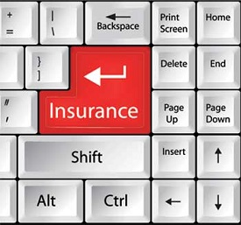
Computer Application - Insurance
Insurance companies are keeping all records up-to-date with the help of computers. Insurance companies, finance houses, and stock broking firms are widely using computers for their concerns.
Insurance companies are maintaining a database of all clients with information showing −
Procedure to continue with policies
Starting date of the policies
Next due installment of a policy
Maturity date
Interests due
Bonus

Slide 31

Computer Application - Education
The computer helps in providing a lot of facilities in the education system.
The computer provides a tool in the education system known as CBE (Computer Based Education).
CBE involves control, delivery, and evaluation of learning.
Computer education is rapidly increasing the graph of number of computer students.
There are a number of methods in which educational institutions can use a computer to educate the students.
It is used to prepare a database about performance of a student and analysis is carried out on this basis.

Slide 32
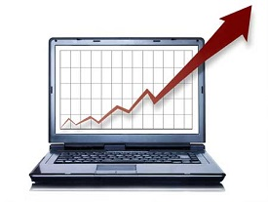
Computer Application - Marketing
In marketing, uses of the computer are following −
Advertising − With computers, advertising professionals create art and graphics, write and revise copy, and print and disseminate ads with the goal of selling more products.
Home Shopping − Home shopping has been made possible through the use of computerized catalogues that provide access to product information and permit direct entry of orders to be filled by the customers.

Slide 33

Computer Application - Healthcare
Computers have become an important part in hospitals, labs, and dispensaries. They are being used in hospitals to keep the record of patients and medicines. It is also used in scanning and diagnosing different diseases. ultrasounds and CT scans, etc. are also done by computerized machines.
Following are some major fields of health care in which computers are used.
Diagnostic System − Computers are used to collect data and identify the cause of illness.
Lab-diagnostic System − All tests can be done and the reports are prepared by computer.
Patient Monitoring System − These are used to check the patient's signs for abnormality such as in Cardiac Arrest, etc.
Surgery − Nowadays, computers are also used in performing surgery.

Slide 34
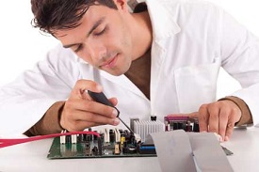
Computer Application - Engineering Design
Computers are widely used for Engineering purpose.
One of the major areas is CAD (Computer Aided Design) that provides creation and modification of images. Some of the fields are −
Structural Engineering − Requires stress and strain analysis for design of ships, buildings, budgets, airplanes, etc.
Industrial Engineering − Computers deal with design, implementation, and improvement of integrated systems of people, materials, and equipment.
Architectural Engineering − Computers help in planning towns, designing buildings, determining a range of buildings on a site using both 2D and 3D drawings.

Slide 35
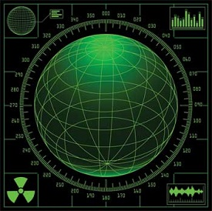
Computer Application - Military
Computers are largely used in defence. Modern tanks, missiles, weapons, etc. Military also employs computerized control systems.
Some military areas where a computer has been used are −
Missile Control
Military Communication
Military Operation and Planning
Smart Weapons

Slide 36
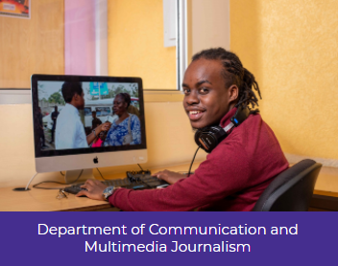
Computer Application - Communication
Communication is a way to convey a message, an idea, a picture, or speech that is received and understood clearly and correctly by the person for whom it is meant. Some main areas in this category are −
E-mail
Chatting
Usenet
FTP
Telnet
Video-conferencing

Slide 37
Additional Learning Material
https://www.learnerscoach.co.ke/history-and-introduction-to-computers/

