Slide 1
MODULE 4: SPREADSHEETS Session 1: Introduction to spreadsheets

Slide 2
Introduction
The goal of this module is to give skills to leaners on how to interact with spreadsheets to solve various needs of an organization.
Spreadsheets are digital workspaces that allow users to manipulate data and generate summaries in graphical format

Slide 3
Module Learning Outcomes
At the end of the module, learners will be able to
1. Enter data in worksheets and navigating worksheets
2. Use formulas and functions to get data summaries using formula libraries
3. Enhance worksheets by formatting cells and worksheets
4. Create theme based chart to give a visual feel of data
5. Edit worksheets in preparation for printing with page setup
6. Get data from external sources
7. Use filters and grouping to organise and summarise data

Slide 4
Tools Required
Microsoft Excel 2010 or higher,
OpenOffice Calc,
Google Sheets

Slide 5
Learning Outcomes
By the end of this session, you will be able to:
Launch the various spreadsheet tools available in the market (MS Excel, Apache Calc and google sheets)
Describe the various menus and tools available for use
Work with the cell, rows and columns (Add and delete rows)
Enter and align data in a cell

Slide 6

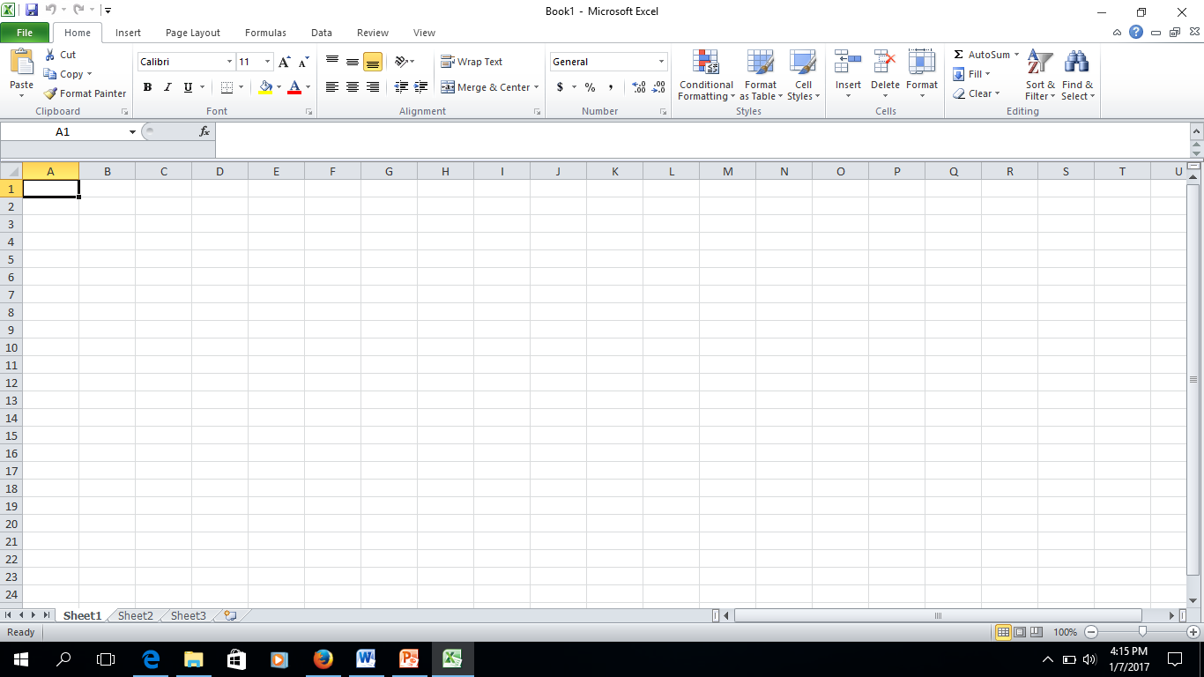
Introduction
A spreadsheet is an application that allows calculations and generation of advanced graphs and charts from the data to be carried out efficiently. Excel is one of the most common spreadsheet applications
In Spreadsheet applications, each document is known as a Workbook and contains a worksheet.
When a new document is opened it has the default name Workbook and contains Sheet1 as the first worksheet. As many worksheets as necessary can be added to a Workbook. Only one sheet can be active at a time.

Slide 7
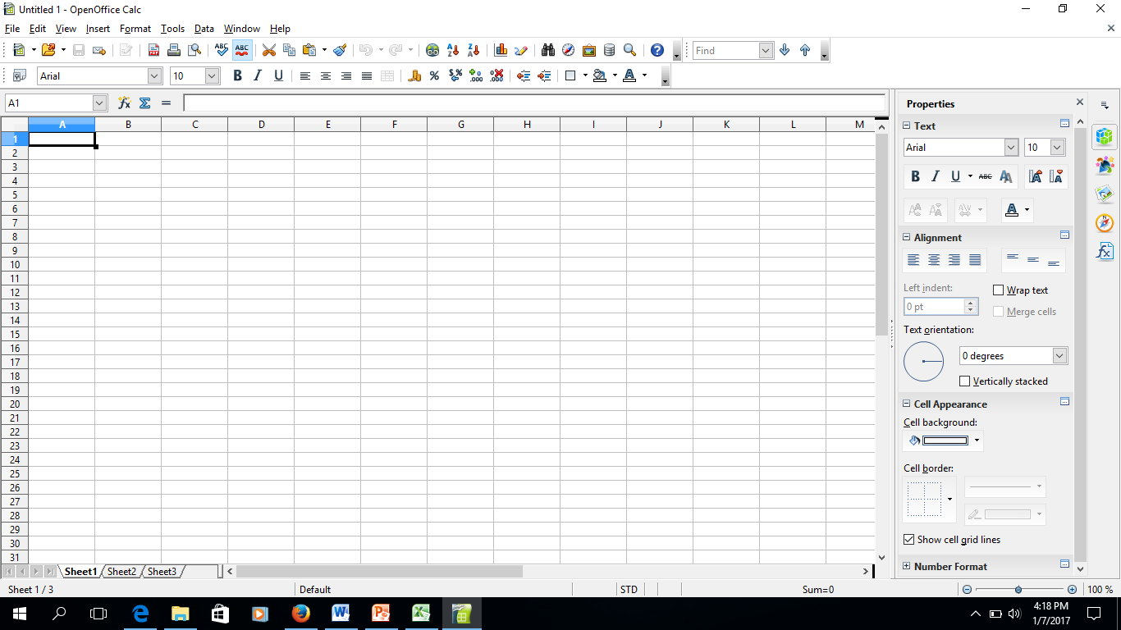
Cont..
The worksheet is made of a table-like sheet with columns, identified with a letter reference (A,B,C,D…) and rows identified with a number reference (1,2,3,4….) The intersection of a row and a column is known as a cell. Each cell is uniquely named relative to its column and row number. This unique name is known as a cell “address” for instance the cell address C5 refers to the data in column C and row 5 of the sheet.
Other cells can be used to refer to the data or formulas in a cell. This is known as referencing.

Slide 8
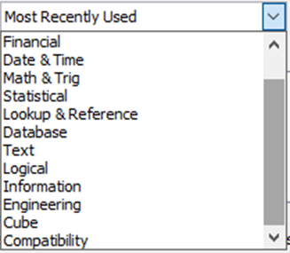
Characteristic of spreadsheets
They allow users to see data in a graphical format using bar graphs, scatter diagrams, trend lines etc.
They do automatic calculations of data once the formulas are put in.
They perform complex data analysis using built in formulas in statistics, engineering, finances etc

Slide 9



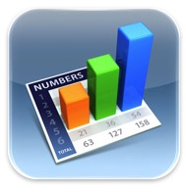
Examples of Spreadsheets
Microsoft Excel by Microsoft
OpenOffice Cal by Apache
Google Sheets by Google
Numbers for Mac by Apple

Slide 10
Platform and Price Comparisons
 | Microsoft Office | Apple iWork | Google Drive | OpenOffice or LibreOffice
Operating systems | Windows and Mac | Mac | Online only | Windows, Mac, and Linux
Apps | iOS, Android, Windows Phone | iOS | Android and iOS | N/A
Cost | Starts at $100 for subscription service (Office 365) | Free | Free | Free

Slide 11

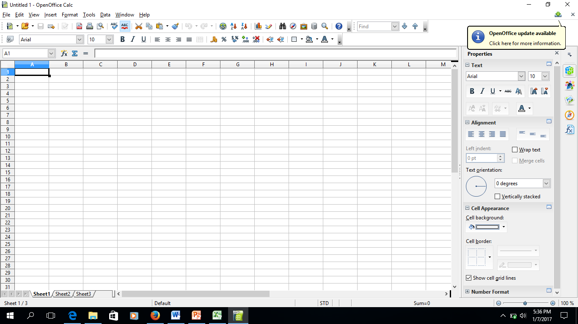
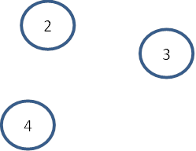
Spreadsheet Interface (OpenOffice Calc)
Title bar- contains the name of the current workbook
Menu bar- contains additional functions available on a workbook. Click each menu to see the options.
Formatting toolbar-icons of formatting shortcuts

Slide 12
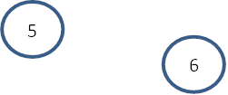
Cont..
Formula Bar-Has two sections. The left shows the cell address of the cell where the cursor is located. The right contains the actual contents of the cell. Cell formulas are also visible in this bar.

Slide 13
Status bar- displays the current view and a description of what the application is currently doing. Results of formulas are also displayed on the status bar.
Tab bar-Shows the sheets on the workbook. Select a tab to make a sheet active.

Slide 14
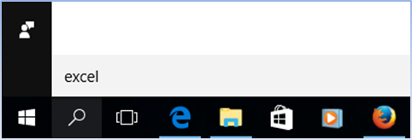
Class Exercise
Open the Microsoft Excel application installed on your computer and select “New workbook”. Use the search icon on the status bar to search for the application
Using the mouse, click in cell A2 to place the cursor and type Student Name, use the right arrow key on the keyboard to move to cell B2 and type Course.

Slide 15
Using the arrow keys or the mouse to place the cursor in the respective cells, populate cells A3-A9 with student names, B3-B9 with courses.
Student Name | Course
Robert Mugabe | PSC 101 - Political Science
Bill Gates | MCS 101 - Microsoft
Mark Zukerberg | FBK 101 - Facebook
Jerry Yang | YHO 101 - Yahoo
David Filo | YHO 101 - Yahoo
Kevin Systrom | ING 101 - Instagram
Mike Krieger | ING 101 - Instagram

Slide 16
To insert an additional row, select row 7 (the row where a new row will be inserted above), which is where we want to insert a new row. Select the same number of rows as you want to insert. To insert four rows, select four rows. In our example, we have selected only one row, therefore only one row will be added.

Slide 17
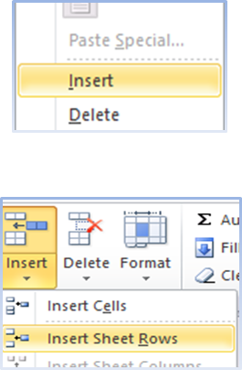
Method I - right-click on Row 7 and in the popup, select insert. This will automatically shift the rest of the rows down, to make room for the new row.
Method II- On the Home tab, Cells grouping, select Insert Sheet Rows. This will automatically shift the rest of the rows down, to make room for the new row.
Added rows appear above the selected cell or row.

Slide 18
Populate the new row with the student name “Moses Musa” taking a course in “EXD 101 - Exodus”.
To insert an additional column, select column A (the column where a new column will be inserted before)
Method I- right-click on column A and in the popup, select insert. This will automatically shift the rest of the columns to the right, to make from for the new column.
Method II - On the Home tab, Cells grouping, select Insert Sheet Rows. This will automatically shift the rest of the rows down, to make room for the new row.
Populate the new column with the heading Student Number and populate the rest of the cells with student numbers as shown.

Slide 19
Student Number | Student Name | Course
Student Number | Student Name | Course
DAC/000/2017 | Robert Mugabe | PSC 101 - Political Science
DAC/001/2017 | Bill Gates | MCS 101 - Microsoft
DAC/002/2017 | Mark Zukerberg | FBK 101 - Facebook
DAC/003/2017 | Jerry Yang | YHO 101 - Yahoo
DAC/004/2017 | Moses Musa | EXD 101 - Exodus
DAC/005/2017 | David Filo | YHO 101 - Yahoo
DAC/006/2017 | Kevin Systrom | ING 101 - Instagram
Adjust the Column width by taking the mouse pointer between the two columns and double click the mouse button.
Added columns appear to the left of the selected cell or above selected column.
When new rows and columns are added, cell references are automatically adjusted.

Slide 20
Cont...
To delete rows or columns, select the row or column to delete, on the Edit menu, click delete. Rows or columns shift up or to the left to fill the space left by the deleted for or column.
Delete the row that has called Robert Mugabe
Note: Spreadsheet applications also adjust formulas if a cell is deleted. The #REF error is displayed if a formula references a deleted cell.
Select cells A2,B2 and C2,set the font to Bold and alignment to Center.
Save the workbook as StudentMarks1.xlsx, in your class folder.

