Slide 1
MODULE 5: PRESENTATIONS

Slide 2
Introduction
The goal of this module is to equip learners with skills on how to create powerful presentations, which will have an impact to the audience.

Slide 3
Module Learning Outcomes
At the end of the module, learners will be able to:
Create new presentation specific to particular themes
Use different templates to match user needs
Use Images, Illustrations and Links to enhance the presentation with multimedia features
Apply slide animation, transition and create special presentation with timings feature
Create different charts and tables
Manage presentations themes and backgrounds

Slide 4
MODULE 5:PRESENTATIONS SESSION 1A: The PowerPoint Interface

Slide 5
Definition
Presentation software is an application that is used to prepare slide show based presentations with a graphical approach.

Slide 6
Learning outcomes
By the end of this session, you will be able to:
Explain what presentation software is and the different types of applications software available in the market
Describe the presentation interface and major presentation applications
Create a new presentation and add different slide templates
Alter the layout of new/existing slides

Slide 7

Introduction to presentation applications
A presentation program is a software package used to display information in the form of a slide show. It has three major functions:
An editor that allows text to be inserted and formatted,
A method for inserting and manipulating graphic images, and
A slide-show system to display the content

Slide 8

Examples of presentation software
Microsoft PowerPoint
It was estimated that there are 30 million PowerPoint presentations given every day and that it has 95% Market share.

Slide 9

Examples of presentation software (2)
Adobe Flash
The animation effects and the ability to import video are stunning. The biggest problem is that it takes a high degree of proficiency to get it to work for you.

Slide 10

Examples of presentation software(3)
Open Office Impress
The free open source presentation technology. It contains a number of features not available in PowerPoint

Slide 11

Examples of presentation software(4)
For those of you using Macs there is a small community of people who use Apple Keynote. It is used by Apple devices

Slide 12

Examples of presentation software(5)
This is a free online (you must have Internet connection) presentation software by Google. It is available under Google apps. Presentation files converted to .gslides.
Slides format cannot be larger than 100 MB. Images inserted cannot be larger than 50 MB, and must be in either .jpg, .png, or non-animated .gif formats

Slide 13
 | PowerPoint | Keynote | Google Slides
Related Software | Part of Microsoft Office365 | Part of the iWork productivity suite | Part of Google Drive’s office suite
Export File Types | In addition to various PowerPoint and Office formats, export formats include .pdf, .xps, .mp4, .wmv, .odp, .gif, .jpg, .png, .gif, .bmp, .tif, .wmf, .emf, and .rtf | Includes .pdf, various PowerPoint files, QuickTime, HTML, Images, and Keynote 2009 | Includes .pptx, .pdf, .txt, .jpg, png, .svg
Audio Import | Yes | Yes | Not at this time, but YouTube videos can be embedded.
Animation and Effects | About 50 effects (Entrance, emphasis, and exit). | About 30 different build animations and 40 transition effects. | About 15 effects.

Slide 14
 | PowerPoint | Keynote | Google Slides
Collaboration | PowerPoint 365 files can be shared if saved to OneDrive. | Invite others to collaborate if your Keynote is set up to use iCloud Drive. | Files are easily shared with online collaborators.
Offline Access | Yes | Yes, as long as the file is saved on your local device. | Files can be accessed offline using the Google Slides app (link to Chrome web store).
Cost | Must purchase through Microsoft. | Free with new Mac, or purchase through the Mac App store. | Free as a part of Google Office. You must create a Google account.
Available for Mac | Yes, although some users claim the Mac version is not as robust as the PC version. | Yes, Keynote was designed for the Mac. | Yes, as long as there is an Internet connection.
Available for PC | Yes | No | Yes, Google Slides resides in the cloud.

Slide 15
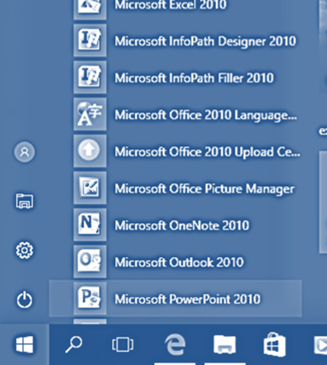

The Microsoft PowerPoint Interface
Class Exercise
On your computer, select Start → Microsoft Office → Microsoft PowerPoint 2010

Slide 16
The PowerPoint interface loads as follows:
The Presentation Window

Slide 17
The presentation window
Stage – Area used to design each PowerPoint slide by adding text, images, charts, graphs and tables
Outline pane- Contains the text from the slides. One can quickly locate a slide and by clicking on it from the outline pane, have it loaded on the stage for editing.
Notes Pane- used to provide additional details or notes that would not otherwise fit in the stage area, or that provide additional information for the slide.
Slide Layout - Used to format the order of tables, charts, graphs and text on a slide. Depending on the type of content that needs to be displayed on each slide, select the appropriate layout.

Slide 18
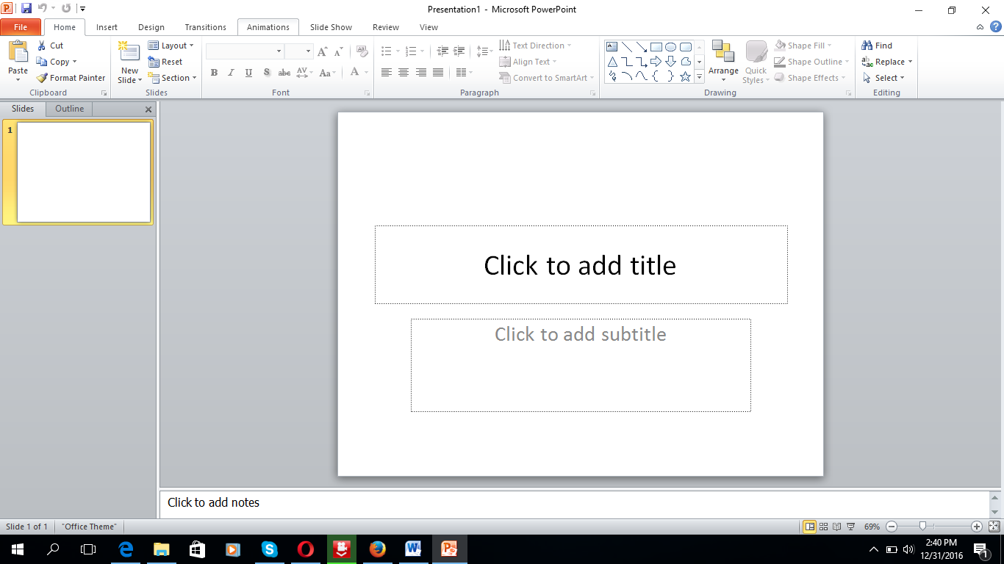
The Graphical User Interface
Menu bar – A menu is a collection of related actions that are grouped together.
The "File" menu, for example, provides options to open a file, create a new one, and save or print -- among others.

Slide 19
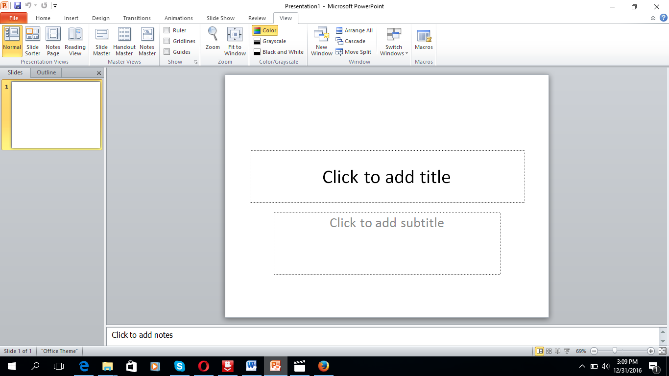
Class exercise
To move from pane to pane, you click on the pane you want. Click on the View tab.
View - Used to modify, print and deliver a presentation.

Slide 20
Class exercise cont’d (2)
Normal View- this is the default view used to design presentations.
Slide Sorter View- changes the size of presentation slides to thumbnails making it easier to organize, sort or rearrange the sequence of slides.
Notes Page- allows additional notes to be created or modified for the current slide.

Slide 21
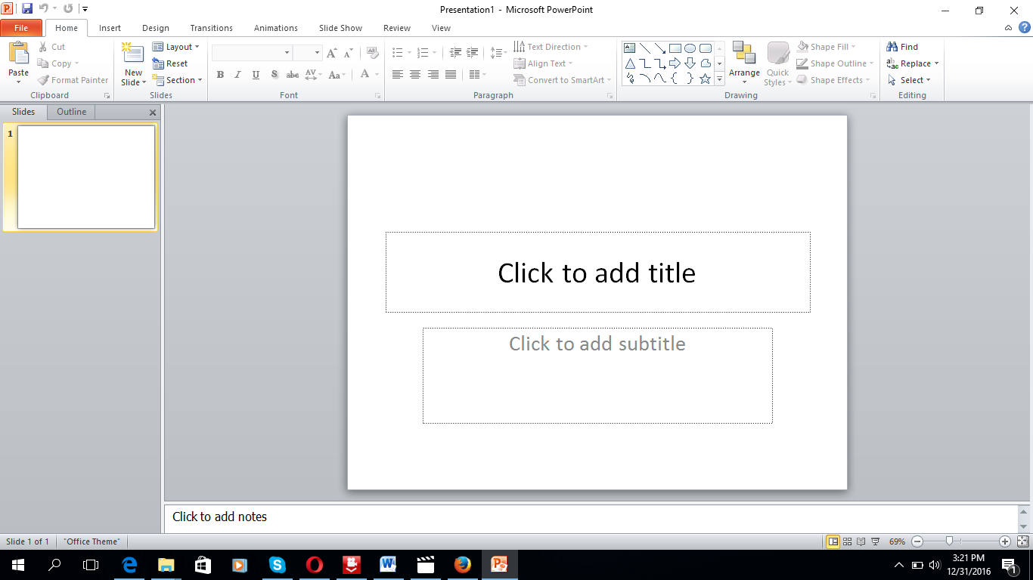
Class exercise cont’d (3)
Title bar – This shows the name of the presentation that is open. When one creates a new presentation, it will be named “Presentation1” and the next presentation will be “Presentation2” and so on. This is the generic name and will change when a user saves the document and gives it a different name, using the File → Save As menu.

Slide 22
Class exercise cont’d (4)
Ribbon – This is as a collection of seven horizontal tabbed toolbars arranged on top of each other. Depending on the presentation software in use, these are: Home, Insert, Design, Animations, Slideshow and Review. At any one time, only one tab is active. One can hide/unhide the ribbon, by clicking on the “V” and “inverted V”, just below the windows control menu.

Slide 23
Class exercise cont’d (5)
Windows control – These are three buttons that enable a user to modify the windows, an area where the document is contained.

Slide 24
Class exercise cont’d (6)
Minimize button – This is indicated as “-“and when clicked on with left mouse button, makes the size of the window disappear without closing it.
Restore Down – Indicated as 2 squares one behind another. When clicked on with left mouse button, makes the size of the window vary without the window disappearing.
Close – This is indicated by an “X”. When clicked on with left mouse button, it closes the window. If a user had modified the presentation, it automatically loads the “Save Changes” Menu.

Slide 25
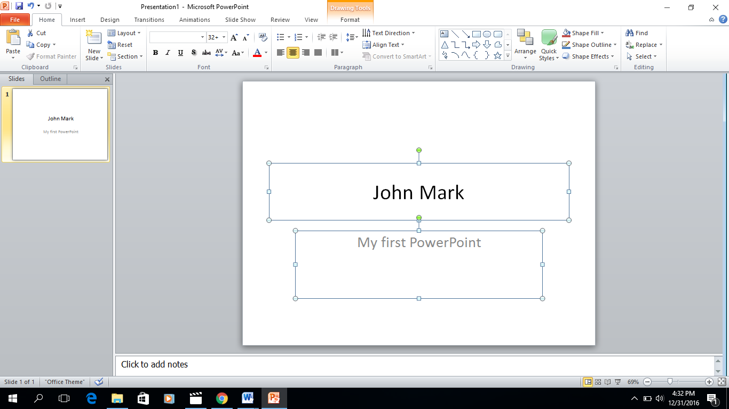
Creating a PowerPoint Presentation
Class exercise
Type the following in the in the first slide
First Place Holder – Enter Your name
Second Place Holder – “My first PowerPoint Presentation

Slide 26
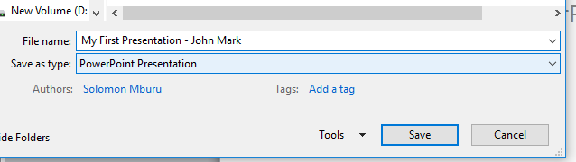
Class exercise cont’d (2)
Select File → Save As → \\classfolder\Presentation\exercises
File Name – My First Presentation – “your names”
Save as Type – PowerPoint Presentation

Slide 27
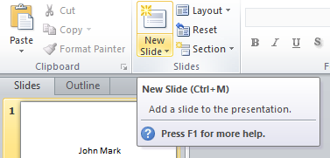
Class exercise cont’d (3)
Add a new slide as follows:
Click on the New Slide

Slide 28
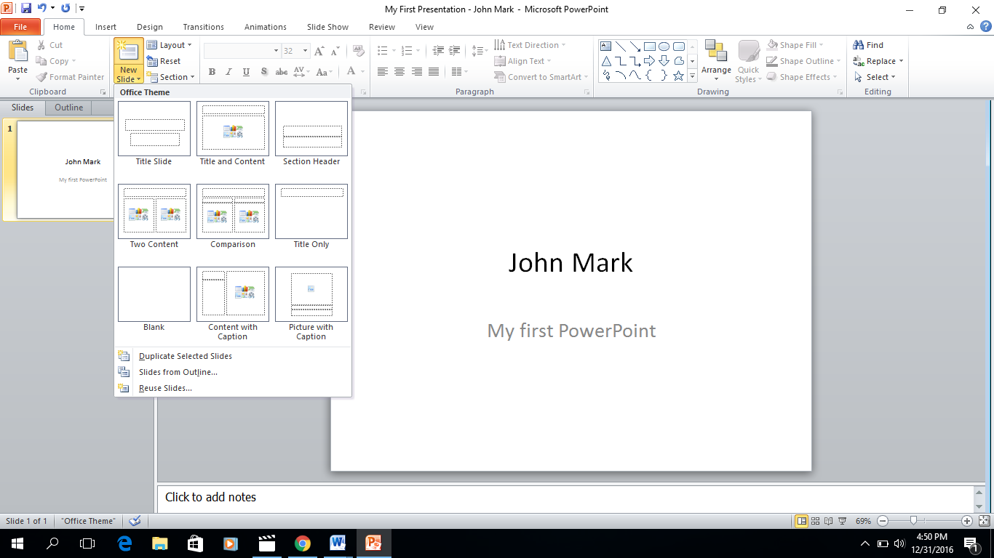
Class exercise cont’d (4)
The Menu for theme is highlighted and allows selecting the theme that you want to be most representative TEMPLATE of what you want to display. Select Title and Content.

Slide 29
Class exercise cont’d (5)
A PowerPoint template is a pattern or blueprint of a slide or group of slides that you save as a .potx file. Templates can contain layouts, theme colors, theme fonts, theme effects, background styles, and even content.

Slide 30
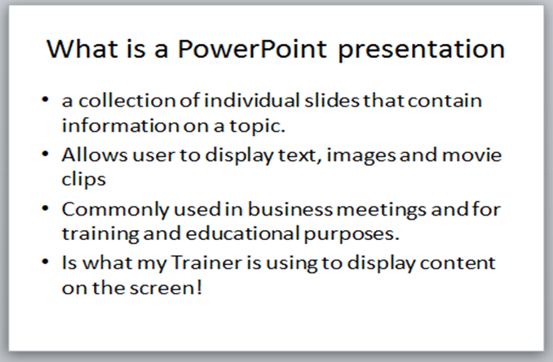
Class exercise cont’d (6)
Enter the following Content in the slide:

Slide 31
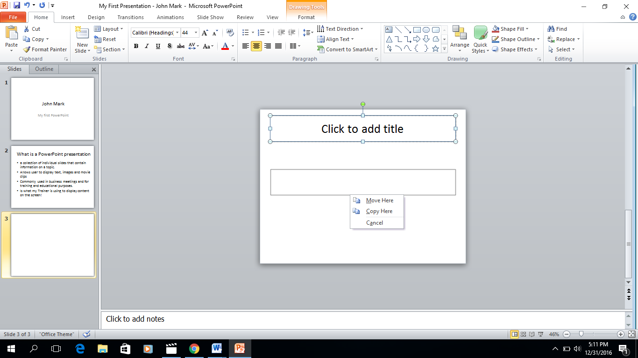
Class exercise cont’d (7)
Insert new slide Theme – Title Only
Select the Title field with left mouse button, hold the button down and drag it to the middle of the slide. Enter the Text “End of Presentation.”

Slide 32
Class exercise cont’d (8)
Close the presentation, when prompted to Save Changes, select OK
Take Home:
Open Google Slides and create the same presentation using Google Slides

Slide 33
Session summary
In this session you have learnt :
What presentation software is and the different types of presentation software available in the market
The presentation interface and major presentation applications
How to create a new presentation and add different slide templates
Alter the layout of new/existing slides

