Slide 1
MODULE 5: PRESENTATIONS
Name of facilitator
DLPDI, Associate Trainer

Slide 2
CREATE PRESENTATION USING EXERCISE ONE CLASS FILE
SAVE IT AS WelcomeEX1

Slide 3
MODULE 5:PRESENTATIONS
SESSION 2A: Adding graphics

Slide 4
Learning outcomes
By the end of this session, you will be able to:
Add pictures and clipart in a presentation
Add illustrations in a presentation: Shapes, SmartArt and Charts
Add videos and audio files in a presentation

Slide 5
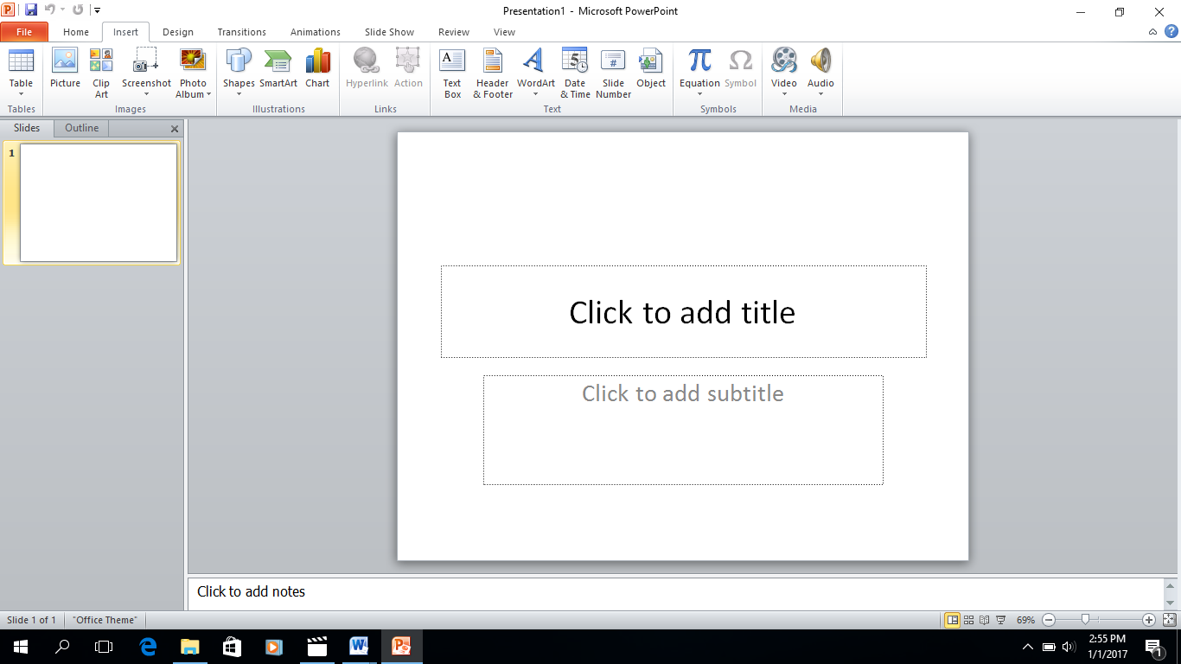
Introduction to the tools
With graphics, one is able to make visually appealing presentation.

Slide 6
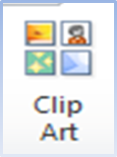
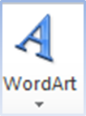
The tool bar icons to use are:
        Pictures- inserts pictures to your presentation. You can locate photos on your local drive to insert into the presentation.
        Clip Art- these are pictures and symbols that are pre-defined with the presentation application in use. Additional ClipArt pictures and symbols can be downloaded from the Internet
        WordArt- this is a text-modifying feature that allows text to be presented with additional visual effects such as shadow, reflection, 3D-rotation and bevel. These effects can also be added to WordArt shapes

Slide 7
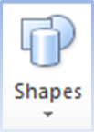
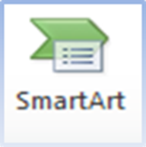
The tool bar icons to use are:
        Shapes - used to draw certain aspects of a presentation. Symbols allow the addition of special characters that are not available on the keyboard such as currencies, fractions, trademark and copyright symbols
        SmartArt- used to graphically represent text data. SmartArt can be used to present :
        Lists-create grouped blocks of information
        Process- create a diagram to show steps or a timeline
        Cycle-create a diagram to show a continuous process
        Hierarchy- create a diagram that shows ranked information
        Relationship- show how information or ideas are associated
        Picture- Create a diagram that has pictures

Slide 8

Other tool bar icons
          You can add audio, such as music, narration, sound bites, and more to your presentations to add emphasis and make it more interesting.

Slide 9
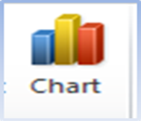
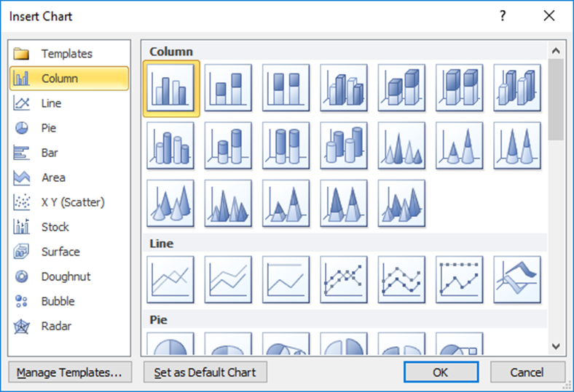
Other tool bar icons:
          Charts- Charts are useful in presenting numeric data. PowerPoint has different chart types to present different types of data in a presentation

Slide 10
Chart types:
Column Chart- compare values across categories
Line Chart- Display trends over time
Pie Chart- Display contribution of each value to a total
Bar Chart- compare multiple values
Area Chart- Display differences between data sets over time
Scatter Chart- Compare pairs of values
Other Chart- creates a chart using other chart types or custom chart templates

Slide 11
Class Exercise
This session builds on the WelcomeEX1.pptx presentation.
Locate and open the PowerPoint presentation WelcomeEX1.pptx from the last class session.
Select File → Save As and save the presentation as WelcomeEx2.pptx.

Slide 12
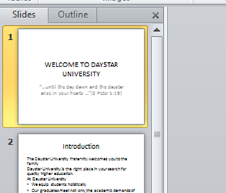
Adding Illustrations to a presentation:
Select the title slide (the first slide) to make it active in the staging window. Select Insert from the Insert tab and select “Picture from File”.
Insert → Picture → daystar.png

Slide 13
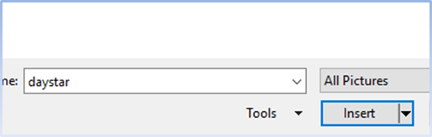
Adding Illustrations to a presentation (2)
In your classroom folder, select the image daystar and click insert OR double click on the image to insert it.

Slide 14

Adding Illustrations to a presentation (3)
Using the mouse, resize or align the image as appropriate so that it fits above the Title WELCOME TO DAYSTAR. Hover the mouse on the image, when the mouse pointer is cross, hold down mouse button and drag.

Slide 15
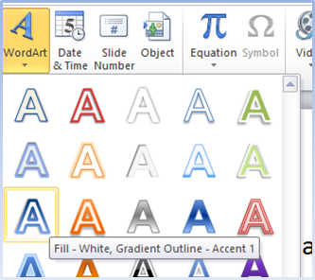
Adding Illustrations to a presentation (4)
To Insert WordArt - Select Slide 3-Our Core Values, select Insert from the menu bar, click WordArt. Select one of the WordArt options available and type the text “Let your light shine”
Insert → Word Art → Fill: White, Gradient Outline – Accent 1

Slide 16
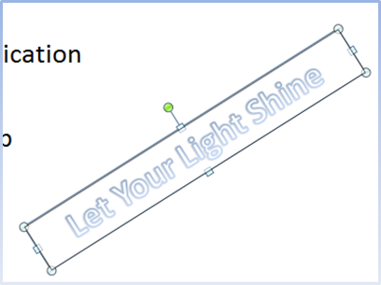
Adding Illustrations to a presentation (5)
Adjust font size to 40. Rotate and adjust the WordArt to fit on the bottom-right corner of the presentation. Hover mouse pointer at the Green dot, hold down mouse pointer and rotate accordingly.
Format the text size, colors and other formatting effects using the options available on the toolbar.
Save the presentation.

Slide 17
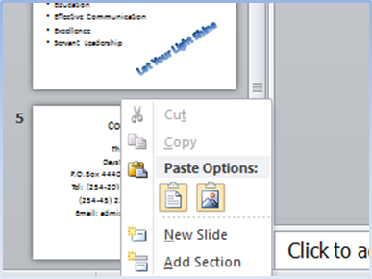
Adding Pictures to a Presentation
Add a new slide before the Contact Us Slide. Add the slide title “Student Leaders”.
  Method I- Click the slide outline area to the left and on the mouse, use the right click button to bring up the pop up menu. Select insert new slide.

Slide 18
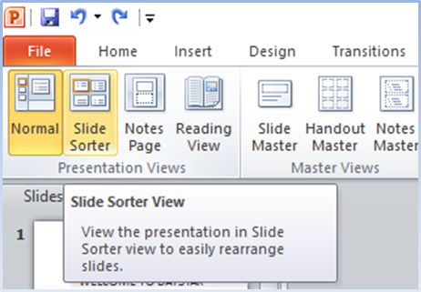
Adding Pictures to a Presentation (2)
  Method II- Insert a new slide from the Insert menu. If the slide is added to the bottom of the contact as slide, rearrange by
      Dragging it above with the mouse.
      Selecting View tab, select “Slide Sorter ”. Use the mouse to rearrange the slides. Revert to Normal view once done.

Slide 19
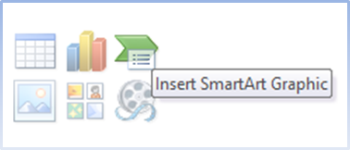
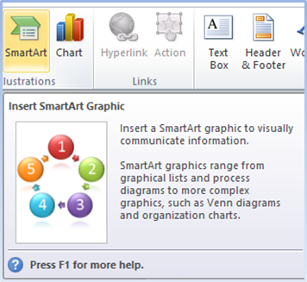
To Insert SmartArt
Method I- In the main text area, locate the SmartArt Graphic icon.
Method II- Select Insert → SmartArt from the Insert tab..

Slide 20
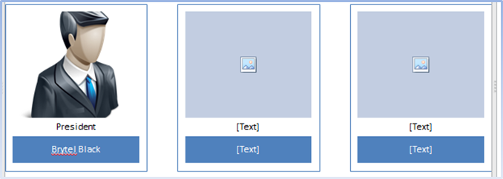
To Insert SmartArt (2)
Select SmartArt → Picture →Captioned Pictures layout. Hint: Mouse over each graphic to view its name.
In each of the picture boxes of the SmartArt, insert the leader image in the class folder. Under each picture, change the [Text] to the position the student leader holds. In the next [Text] section, add the name of the student leader.

Slide 21
To Insert SmartArt (3)
To add or delete SmartArt shapes to the SmartArt Graphic
    Click on the SmartArt graphic to expand a Text Pane to the left, locate the “+” button. The text pane can also be used to add, modify or rearrange the smart art graphics
On the toolbar, change the smart art graphics style such as its colors.
  Select the name labels, Design → Change Colors → Colorful – Accent 1

Slide 22
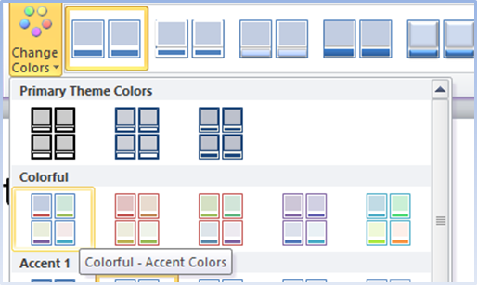
To Insert SmartArt (4)
Save the presentation.

Slide 23
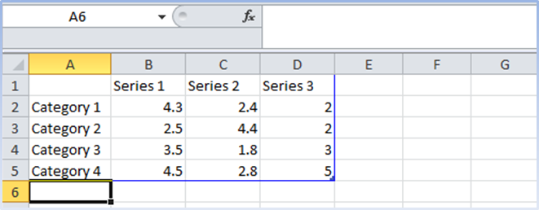
Working with Charts
To insert a chart, add a new slide below “Students Leader” slide. Add the Title “Graduation Statistics”. Select Insert → Chart → Column → Clustered Column.
A new page as shown below will be opened in excel.

Slide 24
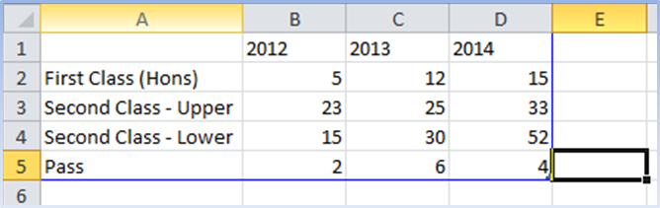
Working with Charts (2)
In each of the cells, enter the following data and click save. This will automatically take you back to the PowerPoint presentation, where a column chart has been added.
Save the presentation.

Slide 25
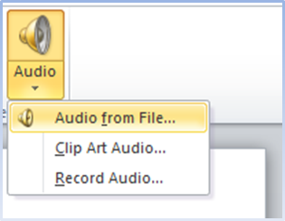
Adding Media Files
To add media files to a presentation – A media file such as audio, can be added to play for the duration of the presentation or at certain points of the presentation.
While still on the “Graduation Statistics” slide:
Select Insert → Audio → Audio from File.

Slide 26
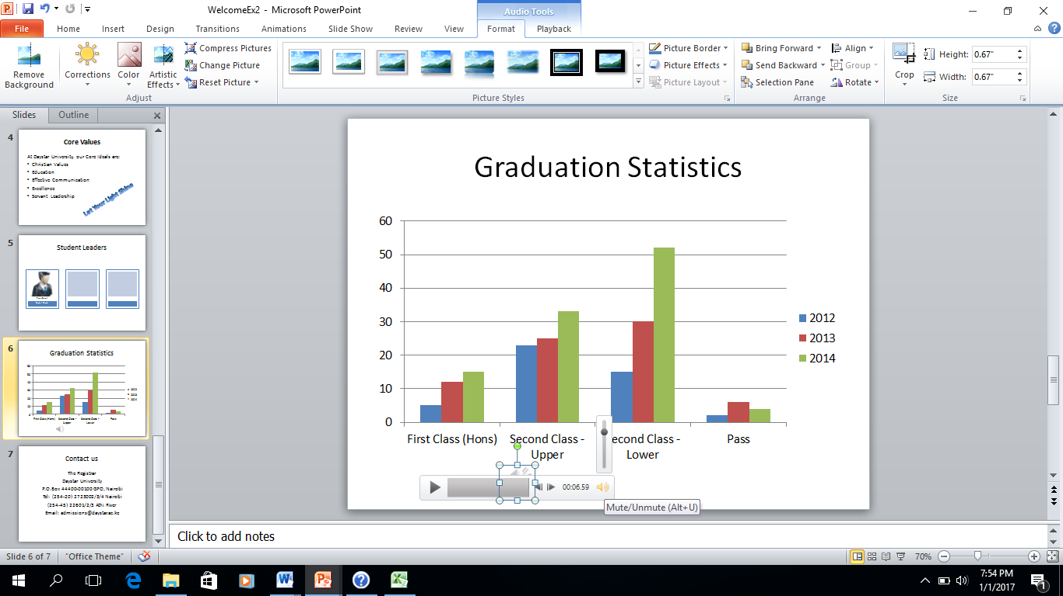
Adding Media Files (2)
Locate the media file audience_applause.mp3 and add it to the slide. The default setting requires you to click play to hear the effect. Format the effects of sound.

Slide 27
Adding Media Files (3)
To hide the speaker icon, select the speaker icon, on the tool bar, locate format audio, select “Playback options” and select “hide icon during show”
Save the presentation.

Slide 28
Session Summary
In tthis session, you have learnt how to:
Add pictures and clipart in a presentation
Add illustrations in a presentation: Shapes, SmartArt and Charts
Add videos and audio files in a presentation

